Slide 1
Product Decisions

Slide 2
To understand the concept of the product
To understand how to classify products
To become familiar with the concept of product item, product line and product mix and understand how they are connected
To understand the concept of a product lifecycle
To examine product differentiation, product quality, product design and product service
To become aware on how products are positioned and repositioned

Slide 3
The concept of a product
A product is anything you receive in exchange for a sum of money
They can be tangible and intangible and include:
social,
functional and
psychological utilities
A product can be an idea, a service or a good or a combination between the three
When a consumer buys a product they are purchasing the benefits and satisfaction that they thing the product will provide

Slide 4
When products are goods
Products can be classified on the basis of the buyer’s intention
thus:
  consumer products are those purchased to satisfy personal and family needs
  Organizational products are purchased for use in a firm’s operations, to resell or to make other products
Consumer products subdivided into
Convenience -Convenience products are consumer products or services that are frequently purchased with minimum effort and thought ( bread, detergent, soft drinks)
Shopping products are consumer goods that are purchased less frequently and compared with available alternatives. Shopping products require personal selling and advertising and are located in fewer outlets than convenience products. Shopping products can range in price, style and quality and consumers often spend a great deal of time comparing them before purchasing. Examples of shopping products include:
Clothes, Furniture, Electronics, Inexpensive cars, Watches,
Specialty
Unsought products

Slide 5
Specialty products are primarily brand-associated goods and have unique features that attract a particular group of buyers who are brand loyal. Consumers who seek specialty goods purchase them based on two factors:
  Brand Focus — The type of brand matters to consumers searching for specialty products. Consumers of specialty goods are loyal to particular brands and often do not want to accept similar products as substitutes.
  Product Features — Product attributes are essential when it comes to specialty goods; they should offer uniqueness and quality.
Unsought products are products that consumers are unaware of or do not normally buy. They often require heavy advertising and aggressive selling techniques because consumers are not interested in them or find them unpleasant to think about. Some examples of unsought products include:
Fire extinguishers
Life insurance
Funeral services
Airplanes and helicopters

Slide 6
Organizational products
Can be divided into
Raw materials
Major equipment
Accessory equipment
Component parts
Process materials
Consumable supplies
Business to business services

Slide 7

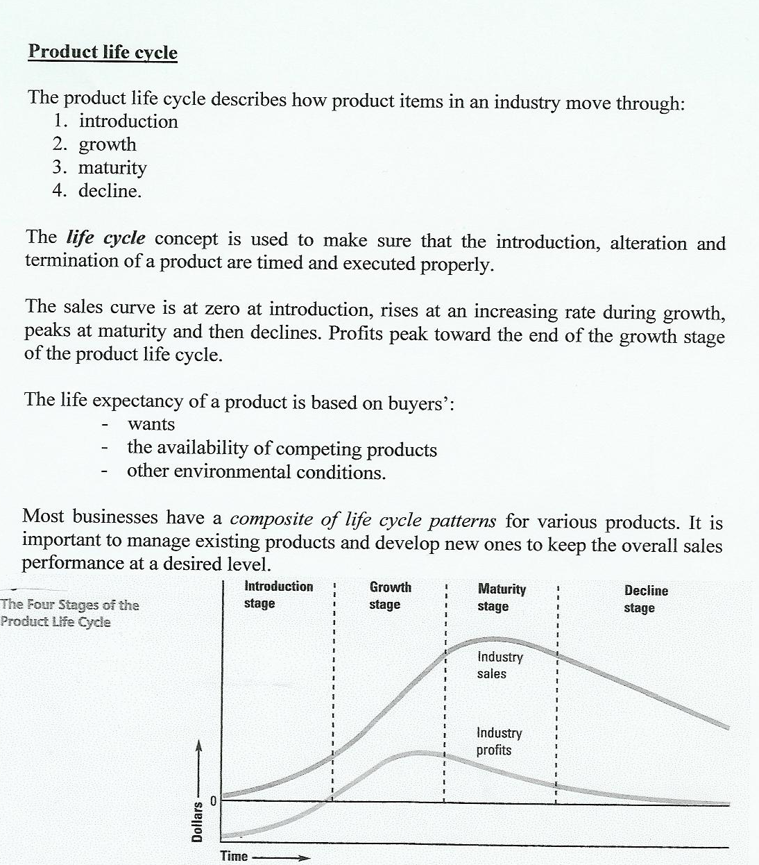

Slide 8
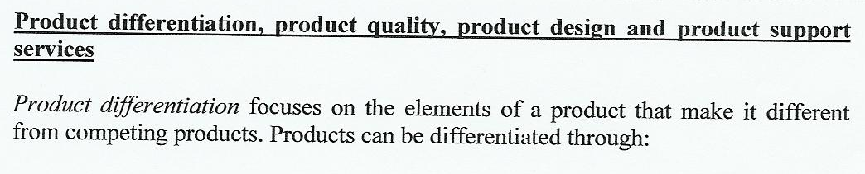
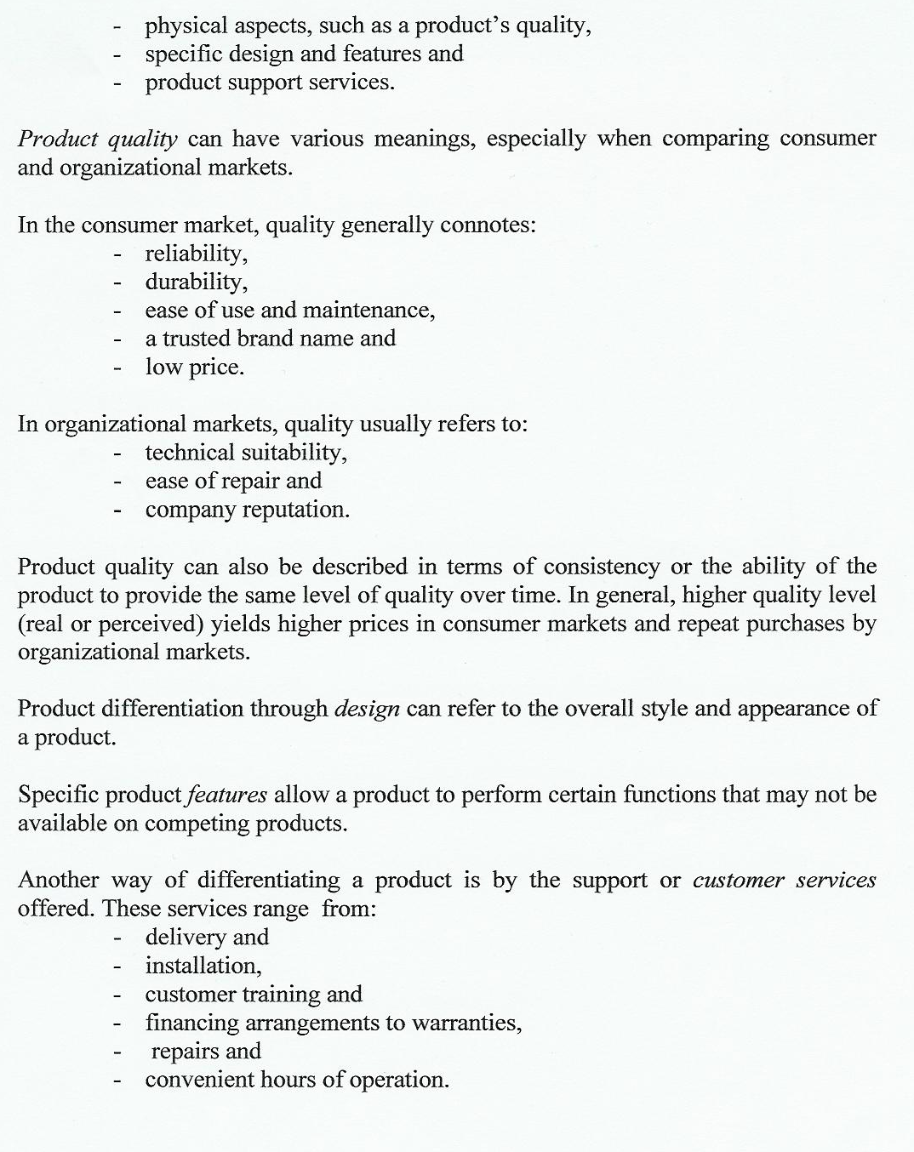

Slide 9
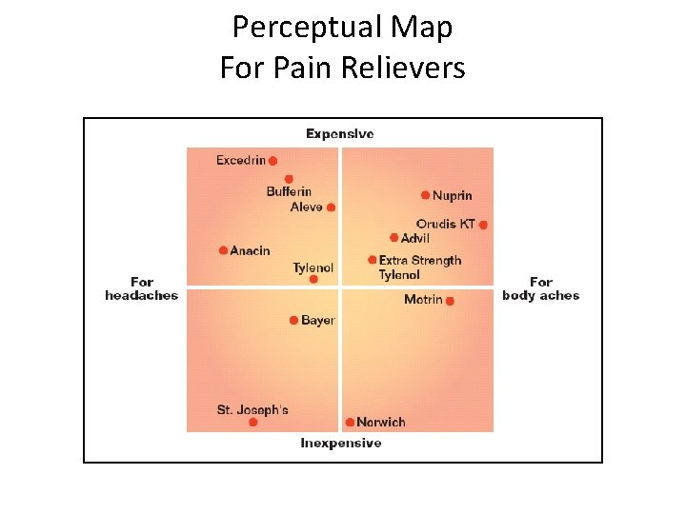
Product positioning refers to the decision and activities intended to create and maintain a certain concept of the firm’s product (relative to competitive brands) or customers minds.
Product positioning is part of a natural progression when market segmentation is used. A firm can position a product to compete head-on with another brand or to avoid competition. Existing products are sometimes repositioned to make them more competitive. Marketers analyze product positions by developing perceptual maps.

Slide 10
Developing and Managing Products
Role of product development in the marketing mix
The product portfolio approach attempts to create specific marketing strategies to achieve a balanced product mix that will produce maximum long-run profits.
Developing new products is a way of enhancing a firm’s product mix and/or adding depth to the product line.
A new product may be:
-an innovation (something new unsold by an organization)
-a product that a given firm has not marketed previously, although similar products may have been available from other organizations
-a product brought from one market to a new market.
How businesses develop a product idea
Before a product is introduced, it goes through the seven phases of new product development.

Slide 11
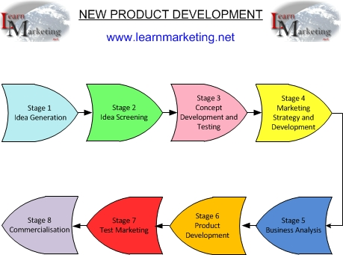
1. The idea generation phase: new products, ideas may come from internal or external sources.

Slide 12
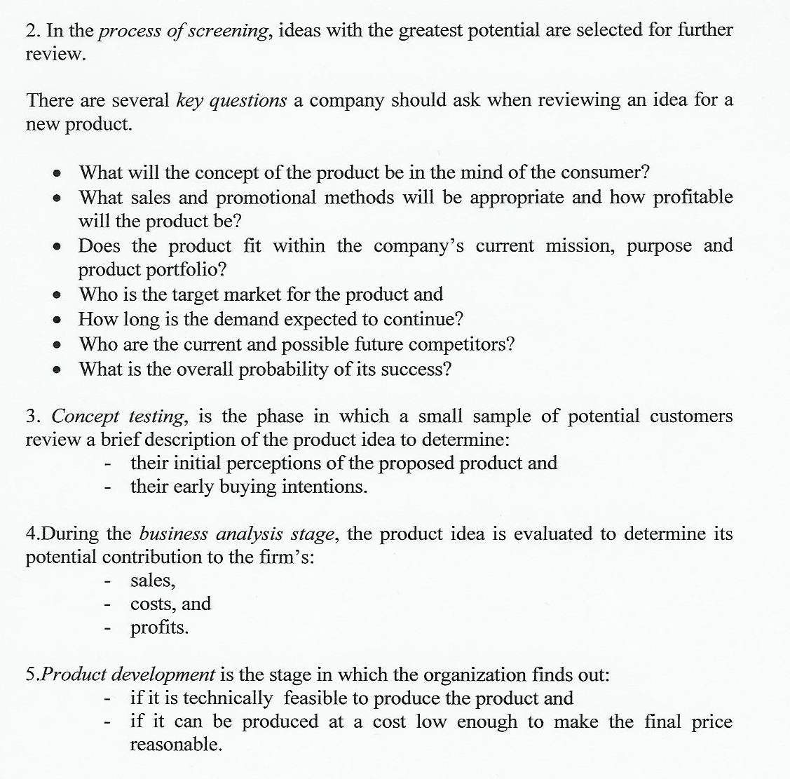

Slide 13
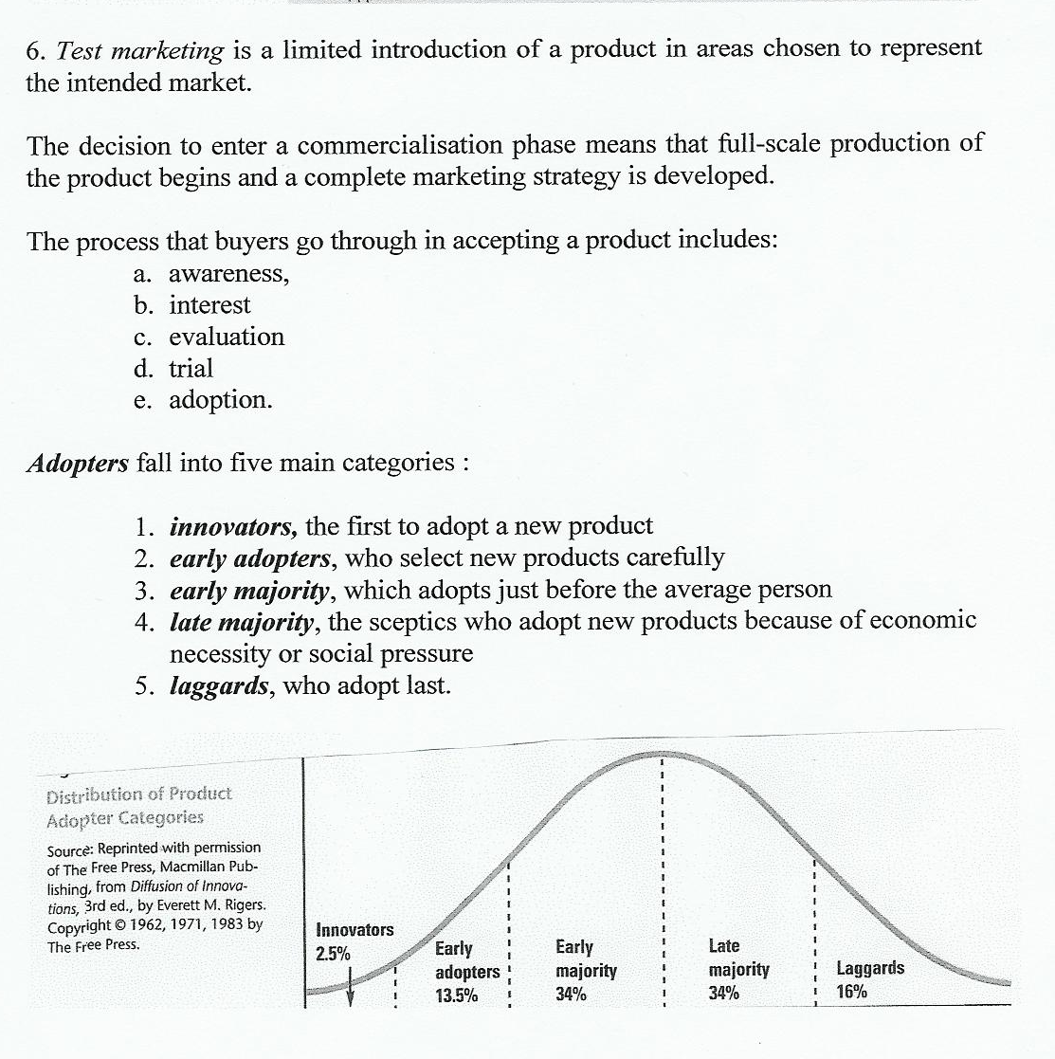

Slide 14
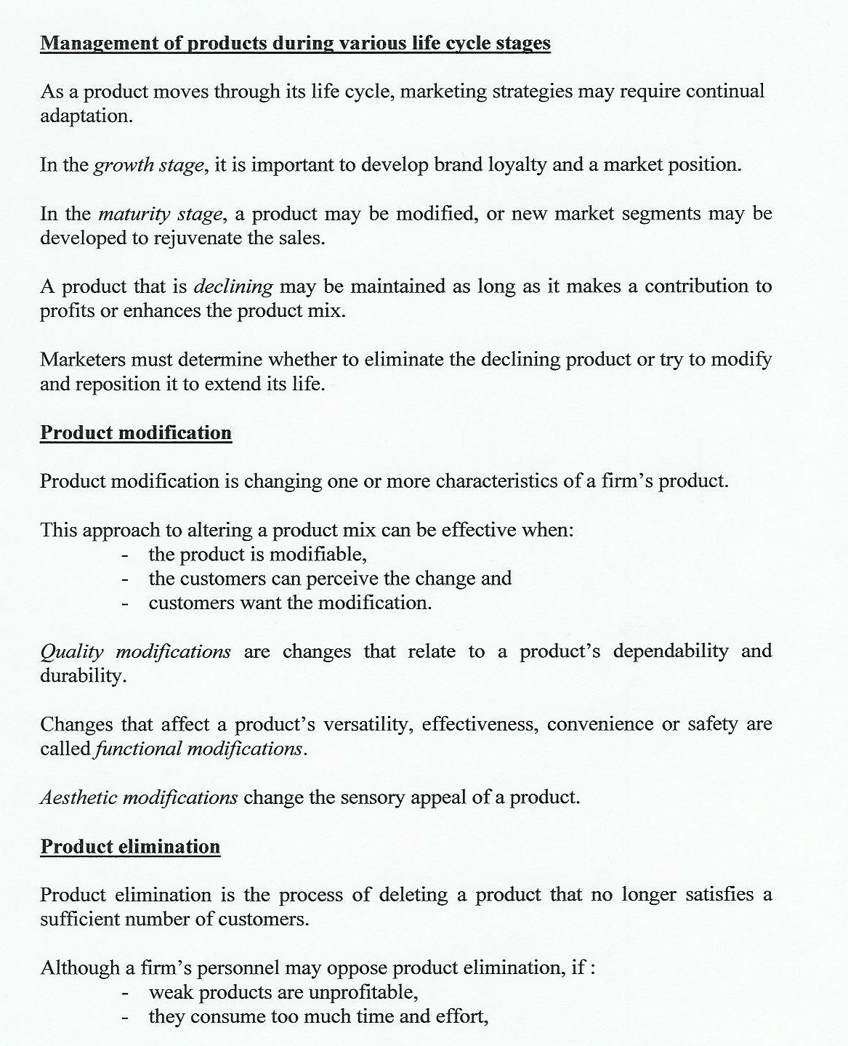

Slide 15
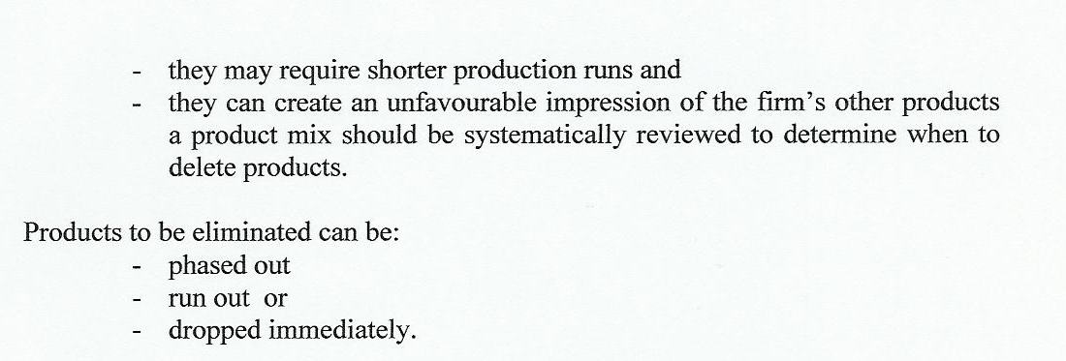

Slide 16
Branding and Packaging
A brand is:
Name
Term
Design
Symbol or
Any feature that identifies one seller’s good or service and distinguishes it from those of other sellers.
A brand name is that part of a brand that can be spoken, the element that can not be spoken is called brand mark.

Slide 17
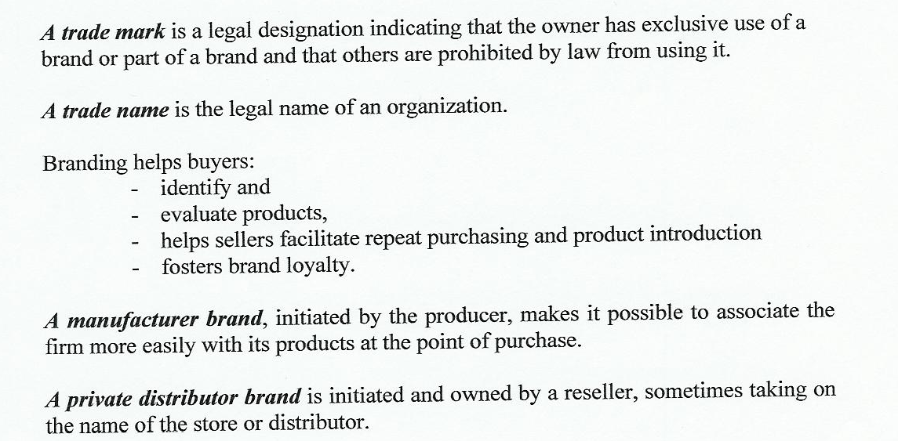
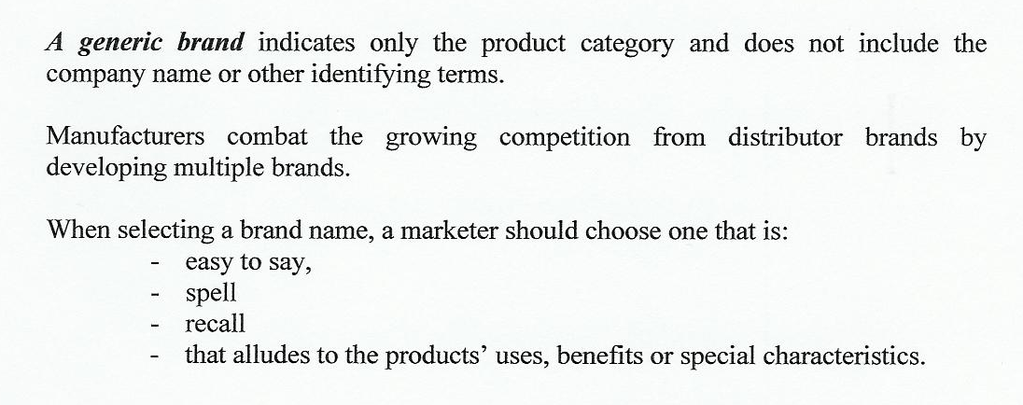
Notes:
A generic brand is a nondescript brand of product that does not have a widely recognizable logo and is sometimes called the "house brand."

Slide 18
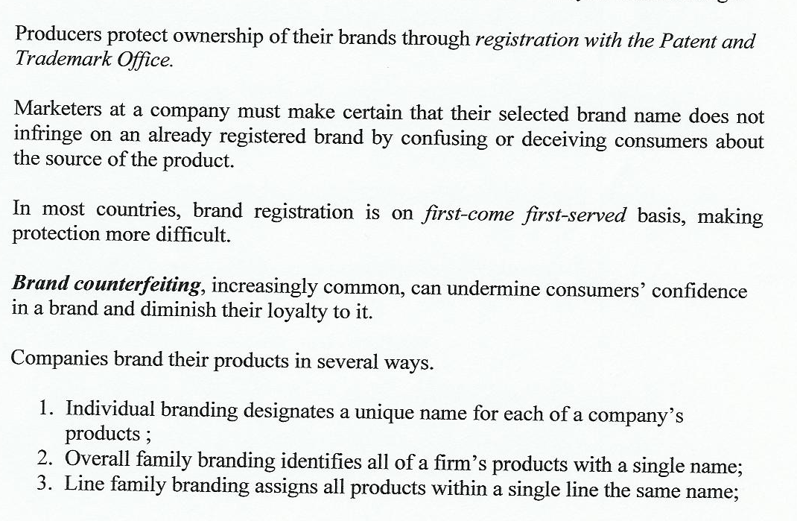
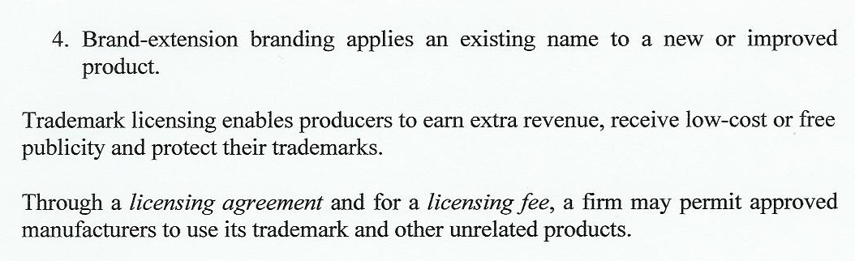

Slide 19
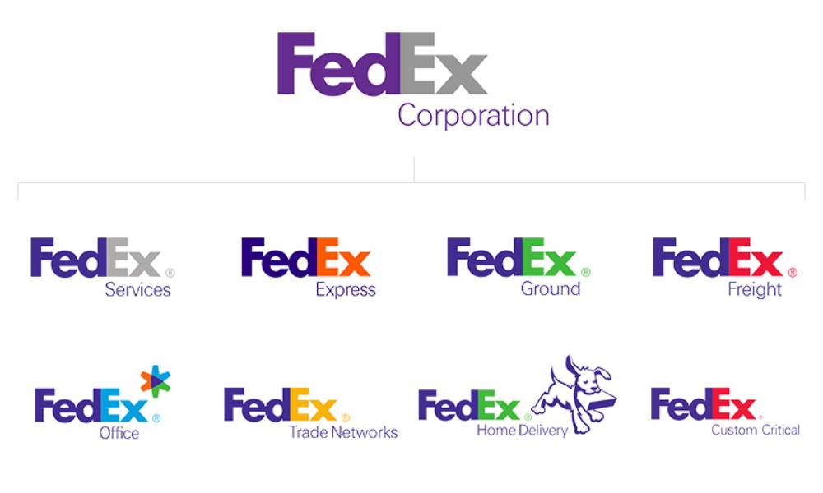
Line family branding

Slide 20
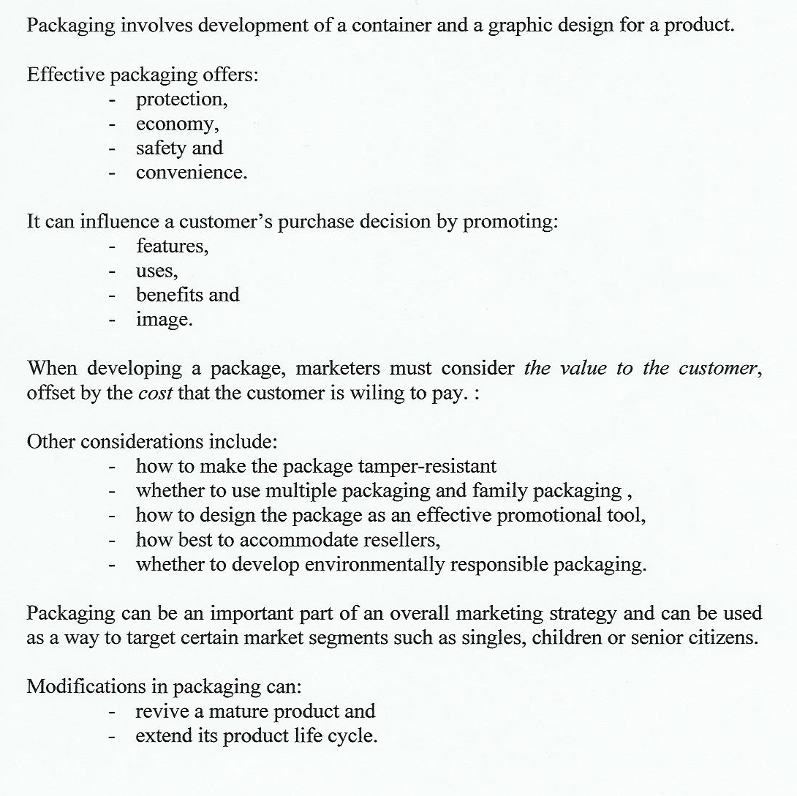
Packaging

Slide 21
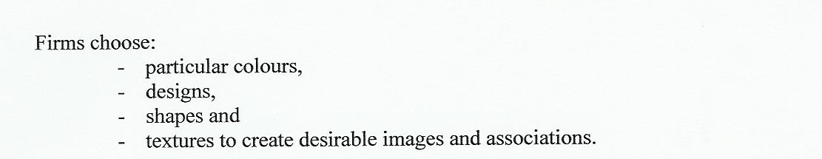
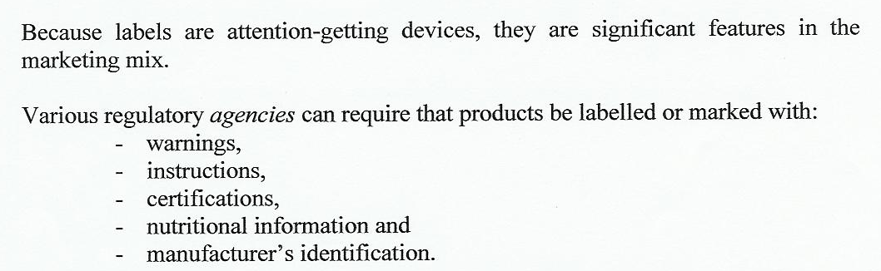

Slide 22

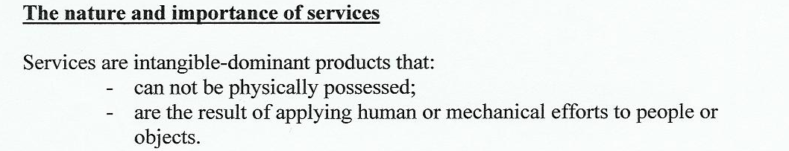
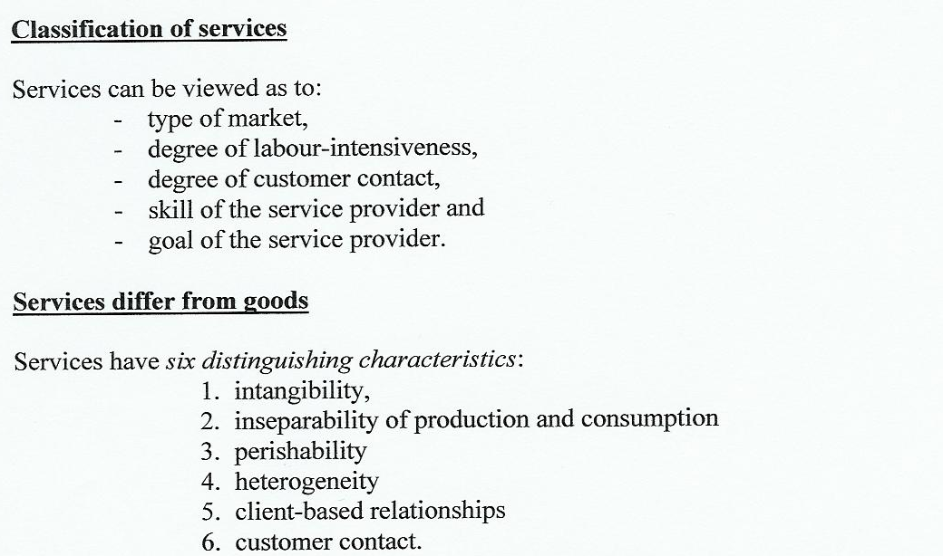

Slide 23
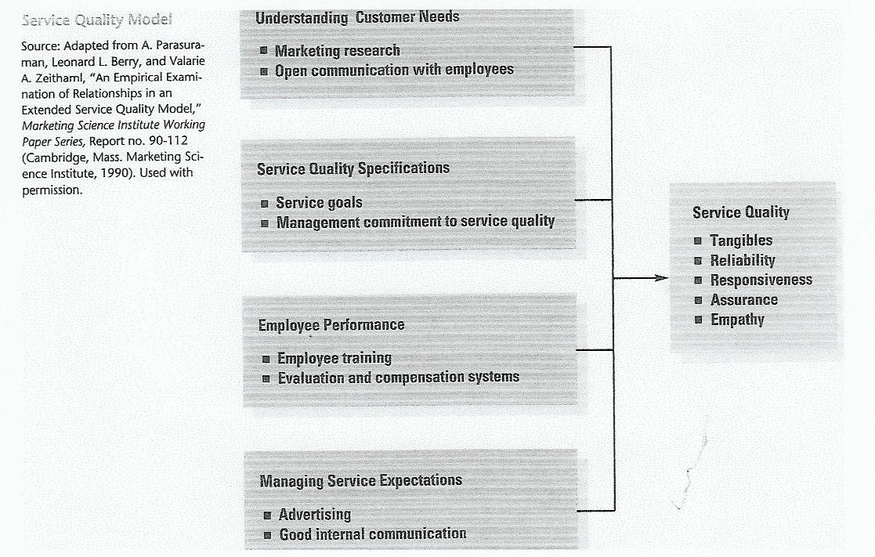

Slide 24
